Slide 1


Insider Threat Detection Using User Behaviour Analytics
TEAM NAME: SHEnergy
TEAM MEMBERS:
ANEEKA REEMAZ A-23BEL1058
ANJUM SANA-23MIA1028
HARSHINI T-23BEL1060
HARSHITA RANJAN-23BEL1010
TANISHA AHLAWAT-23BEL1003

Slide 2


Why Insider Threat Detection Matters
Insider threats are among the hardest to detect because they originate from trusted employees or contractors. Our project addresses this challenge using AI-powered User Behavior Analytics (UBA). In an era where information is currency, ensuring robust security measures not only prevents breaches but also fosters trust among users and stakeholders. It’s the foundation of a resilient digital future.
.

Slide 3
P
Insider Threat Landscape
Traditional threats like phishing and ransomware are well-known, but insider threats are invisible since they mimic normal behavior. Detecting abnormal logins, mass downloads, or misuse of privileges is crucial. Hackers exploit vulnerabilities in software, systems, and human behavior. Understanding these threats is the first step in building effective defenses.

Slide 4




Key UBA Principles
Integrity: Detect suspicious modifications or misuse
Availability: Maintain service uptime against insider sabotage
Confidentiality: Prevent unauthorized file exfiltration
Ensuring sensitive information is accessible only to authorized users.
Maintaining data accuracy and preventing unauthorized modifications.
Guaranteeing that information and systems are accessible when needed.

Slide 5


Challenges in Insider Threat Detection
Challenges include: - Huge, complex logs analysts cannot monitor manually - Too many false positives in alerts - Lack of explainability in anomaly detection - SOC teams overloaded with irrelevant alerts Additionally, human error remains a significant vulnerability. Addressing these challenges requires a holistic approach that combines advanced technology, strategic.

Slide 6


UBA-Driven Technologies
We apply advanced techniques like: - Isolation Forest & Autoencoders for anomaly detection - AI-powered alert explanations - Peer group comparison - Risk forecasting for proactive defense Artificial intelligence and machine learning enable real-time threat detection, while blockchain provides secure and transparent data management. Zero-trust architecture is redefining access control by ensuring that every user and device is continuously verified before gaining access

Slide 7
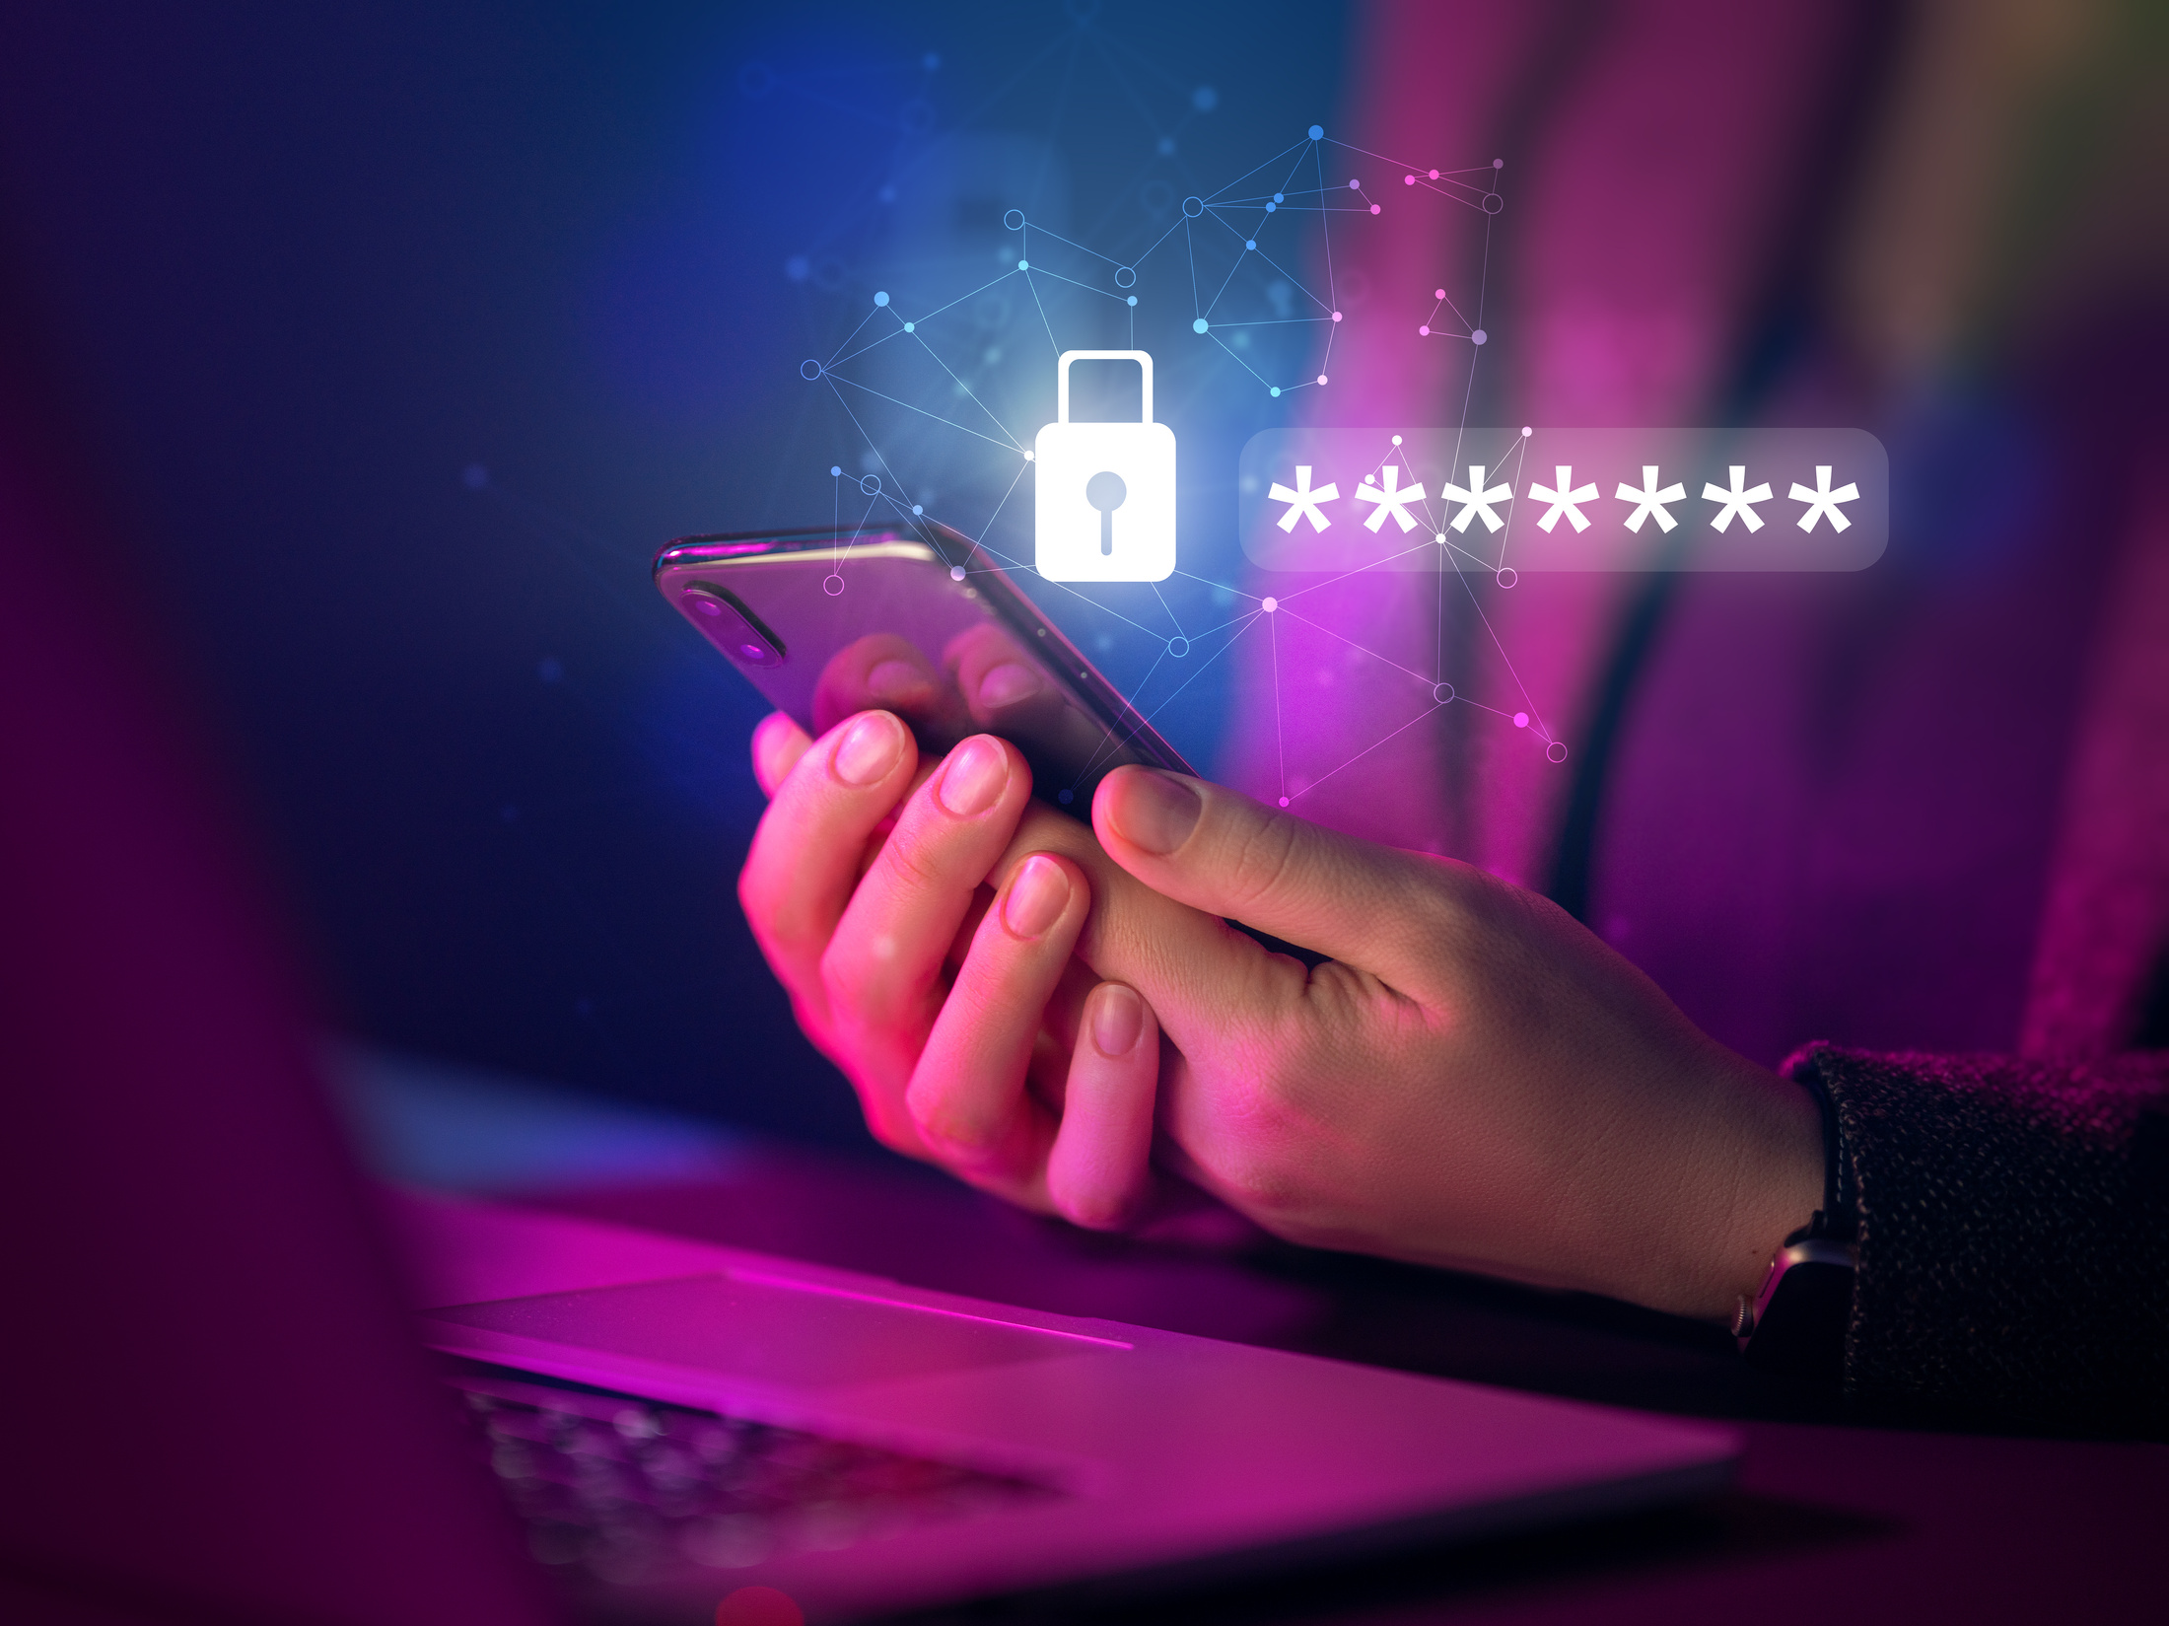
Role of UBA in Security
UBA continuously monitors: - File access and downloads - Login/logout activity - Command executions It flags anomalies, assigns risk scores, and provides SOC teams with actionable insights. Modern encryption methods like AES and RSA secure communications and transactions, ensuring that even if data is intercepted, it remains unintelligible. Encryption is a fundamental layer of defense in the digital world.

Slide 8

Dashboard Walkthrough
Our dashboard includes: - Real-time activity dashboard - Anomaly alerts panel - Risk scoring system - User detail timelines - Export options (CSV/PDF) Innovations: Heatmaps, peer comparisons, risk forecasting, gamified SOC view. Regular training sessions, multi-factor authentication, and the enforcement of strong password policies empower employees to become active participants in maintaining security.

Slide 9

Impact of Insider Threats
Insider threats cost organizations millions annually. Our solution reduces costs by: - Detecting earlier - Reducing false positives - Providing proactive forecasting - Enabling quick remediation actions From data breaches that expose sensitive information to ransomware attacks that paralyze operations, the impact is far-reaching. Prevention is always more cost-effective than recovery. Investing in cybersecurity infrastructure is an investment in long-term resilience and trust

Slide 10


Our Workflow & Contributions
Frontend: React + Tailwind + Tableau integration Backend: Flask/Node APIs for logs Data: Synthetic logs, anomalies, risk scores Innovation: AI explanations, forecasting, collaboration notes Practicality: Role-based views, quick remediation actions Simple practices such as using strong passwords, avoiding suspicious links, and regularly updating devices can prevent most attacks. Staying informed about potential threats and adopting a cautious online approach ensures personal safety in the digital realm.

Slide 11
Future Scope
Deep learning models for anomaly detection - Enterprise-grade deployment readiness From advanced threat detection systems to secure cloud storage, our offerings are built to protect against ever-evolving threats. Together, we empower our clients to thrive in a secure digital ecosystem

Slide 12
Thank You
Our solution combines robust core features, innovative AI-driven analysis, and SOC-friendly workflows. It is creative, practical, and future-ready. By staying ahead of emerging threats and embracing cutting-edge technologies, we can build a secure digital environment. At Thynk Unlimited, we are committed to shaping a future where cybersecurity is a driver of trust, growth, and opportunity.
-

